Slide 1

E-RETAIL FACTORS FOR CUSTOMERACTIVATION AND RETENTION: A case study from Indian e-commerce customers
Presented By:
Akshay Dinesh Shah

Slide 2
Problem Statement And Understanding
Customer satisfaction has emerged as one of the most important factors that guarantee the success of online stores; it has been posited as a key stimulant of purchase, repurchase intentions and customer loyalty. A comprehensive review of the literature, theories and models have been carried out to propose the models for customer activation and customer retention.
Five major factors that contributed to the success of an e-commerce store have been identified as:
Service quality,
System quality,
Information quality,
Trust and
Net benefit.
The research furthermore investigated the factors that influence the online customers repeat purchase intention. The combination of both utilitarian value and hedonistic values are needed to affect the repeat purchase intention (loyalty) positively. The data is collected from the Indian online shoppers. Results indicate the e-retail success factors, which are very much critical for customer satisfaction.

Slide 3
DATABASE GUIDE
In this project, a dataset was provided containing the details of the participants of a survey, along with their online shopping experiences, preferences, and opinions regarding various ecommerce websites.
The Dataset was first checked for null values, and then the various feature columns were analysed. Exploratory Data analysis was conducted to investigate the relationships that existed between the columns, using various visualization techniques.
The dataset was worked with to study and understand how various Hedonic values, Utilitarian values in combination with several perceived risks helped to understand Customer retention and loyalty to various ecommerce websites.

Slide 4
Content of Dataset
The given dataset consists of :
71 columns
269 rows
The column titled : 'Which of the Indian online retailer would you recommend to a friend?' represents a customer’s loyalty to a website and therefore, its customer retention.

Slide 5
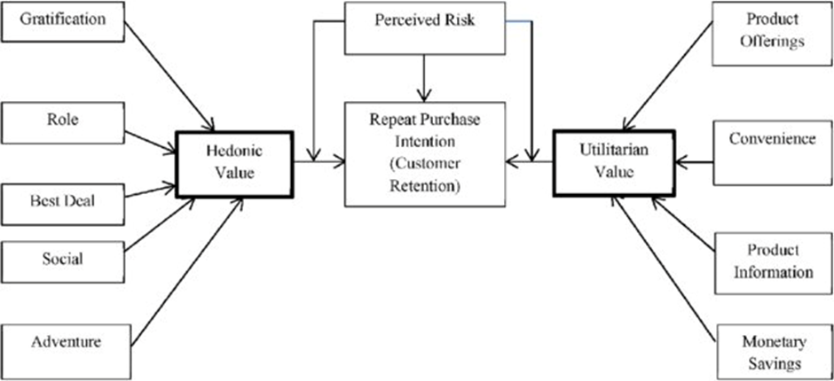
Theoretical Background

Slide 6
Theoretical Background
According to studies it is observed that repeat customer purchase resulting from a long standing loyalty positively affects an e-retailer growth and profitability.
The motivation level of a Customer to shop from an e-retail vendor depends on various factors. They can be psychologically categorised into two broad categories: (a) Hedonistic (b) Utilitarian shopping values.
Hedonistic values represent the excitement, and pleasurable experiences derived from shopping online.
Hedonic shopping values are considered as the most vital factor for online customer satisfaction leading to customer retention. Hedonic shoppers prefer to shop on an e-retail store, which offers more than transaction related interactive controls (information, security, and privacy), but also the aesthetics, emotional value, sensual stimulation etc., which enhances the pleasure of e-retail shopping experience
Utilitarian shopping values are those related to the level of fulfillment as a result of being able to achieve the shopping goals.
The utilitarian shopping values are rational, goal oriented and effective decision-based, which improve the customer satisfaction. Utilitarian e-retail customers concentrate mainly on functions related to specific task, for example: price comparison features, customer review before making a purchase.

Slide 7
Theoretical Background
(a) Hedonistic - Hedonistic values represent the excitement, and pleasurable experiences derived from shopping online. Hedonic shopping values are considered as the most vital factor for online customer satisfaction leading to customer retention. Hedonic shoppers prefer to shop on an e-retail store, which offers more than transaction related interactive controls (information, security, and privacy), but also the aesthetics, emotional value, sensual stimulation etc., which enhances the pleasure of e-retail shopping experience
(b) Utilitarian shopping values - Utilitarian shopping values are those related to the level of fulfillment as a result of being able to achieve the shopping goals. The utilitarian shopping values are rational, goal oriented and effective decision-based, which improve the customer satisfaction. Utilitarian e-retail customers concentrate mainly on functions related to specific task, for example: price comparison features, customer review before making a purchase.

Slide 8
Exploratory Data Analysis
The individual columns of the dataset were first analysed to study their composition and then, with reference to the diagram and the theoretical background of the case study, the relationships between various columns were understood through data visualization using Countplots.
Variable Data-types:
Only the ‘4 What is the Pin Code of where you shop online from?’ is integer type.
All the other columns are objects
Null Values: There are no Null values.
Shape: There are 269 records and 71 features.
Checking for all columns

Slide 9
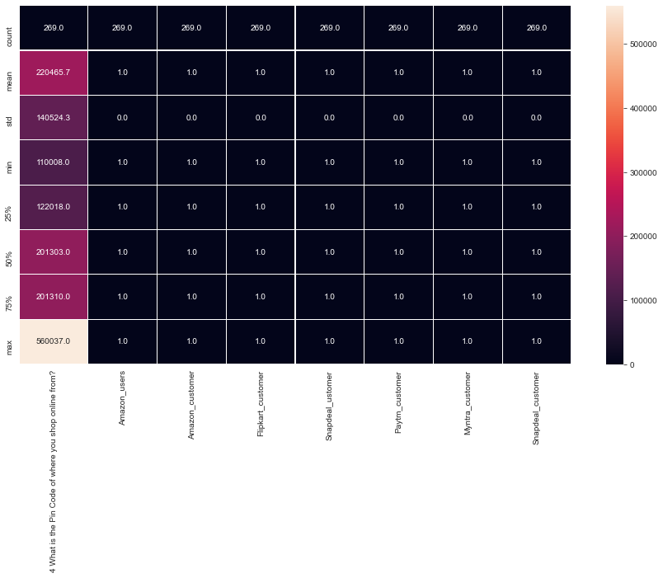
Statistical Summary of DataSet

Slide 10

Data Visualization

Slide 11
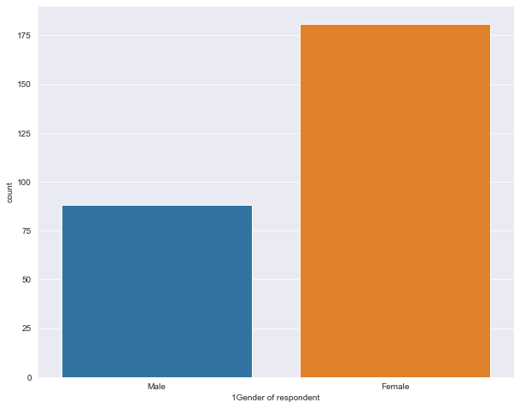
Distribution of the genders in the customers population
The dataset contains more female respondents than male.
Female :- 181
Male :- 88

Slide 12
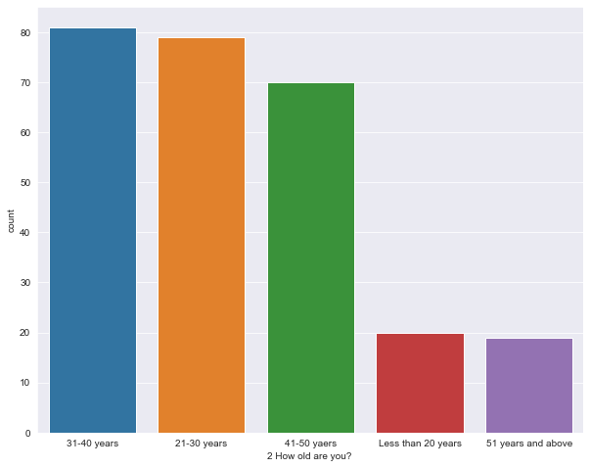
Distribution of Age ranges of the customers
31-40 years 81
21-30 years 79
41-50 years 70
Less than 20 years 20
51 years and above 19
>Most of the respondents are in the age groups of 30s, 20s and 40s as 1st, 2nd and 3rd places.
>The age groups less than 20 and 51 and above are very less.

Slide 13
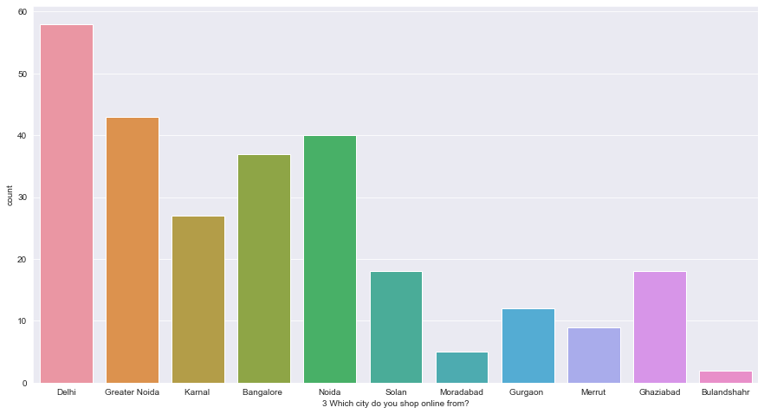
Distribution of customers City Wise
Delhi 58
Greater Noida 43
Noida 40
Bangalore 37
Karnal 27
Ghaziabad 18
Solan 18
Gurgaon 12
Merrut 9
Moradabad 5
Bulandshahr 2
>Among the available cities, Delhi has the
highest number of respondents followed by Greater Noida, Noida, Bangalore in the subsequent places.
>Bulandshahr has the lowest number of
respondents.

Slide 14
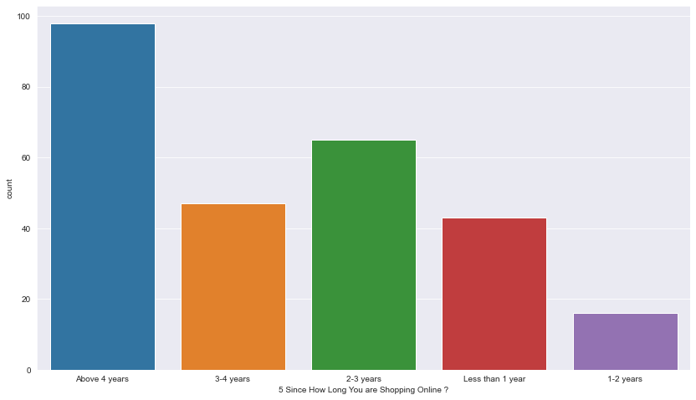
Customers’ online shopping age
Above 4 years 98
2-3 years 65
3-4 years 47
Less than 1 year 43
1-2 years 16
The data shows that Most of the customers are using online shopping for more than 4 years. This indicates that there is a large number of repeat customers. There is also an increased number of customers using online shopping within 1 year than customers using online shopping for 1-2 years. This indicates that online shopping is getting popular again recently although there was a slight decrease in the 1-2 years' population.

Slide 15
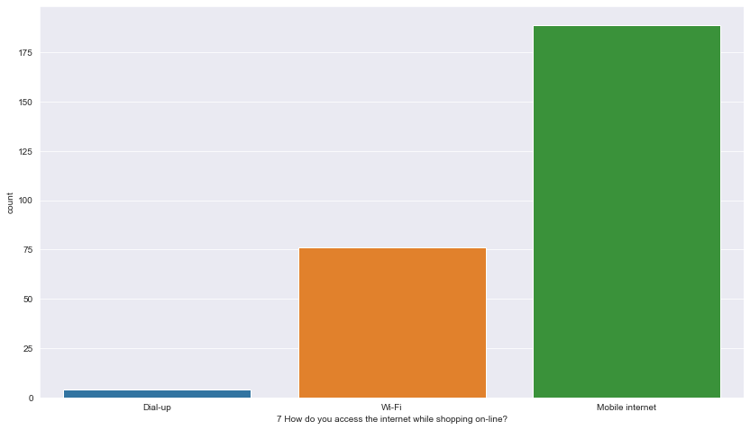
Customer Internet Access while Shopping Online
Mobile internet 189
Wi-Fi 76
Dial-up 4

Slide 16
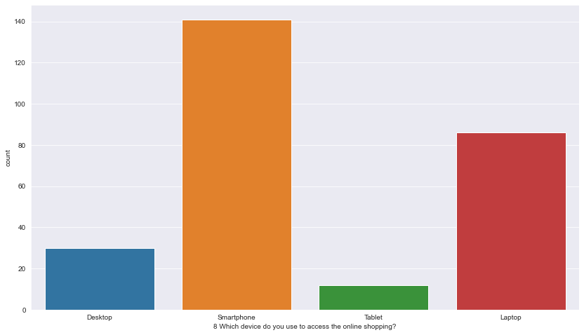
Devices used to access the online stores
Smartphone is the most used device to visit online shopping stores. About 52% of the customers use smartphone to visit the store.

Slide 17
Consumer online shopping activities and preferences
Based on the above graphs it is observed that:
Majority of the consumers have been shopping for over 4 years and have made less than 10 purchases in the last 1 year.
Smartphone and mobile internet are the most popular means of accessing ecommerce websites, with most common screen size being 5.5 inches or greater.
Windows operating system is the most popular on Laptop/Desktop devices while android is the most popular OS on smartphone devices followed by iOS.
Google Chrome is the most popular web Browser, especially on portable devices, followed by Safari.
Search Engine is the most common means of arriving at the E commerce websites, followed by Application and Direct URL.
Most consumers spend over 15 mins browsing an e-commerce website before making a purchase decision.

Slide 18
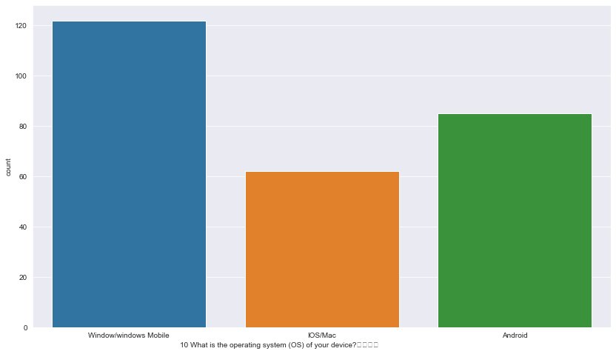
Customer’s Operating System
Window/windows Mobile 122
Android 85
IOS/Mac 62

Slide 19
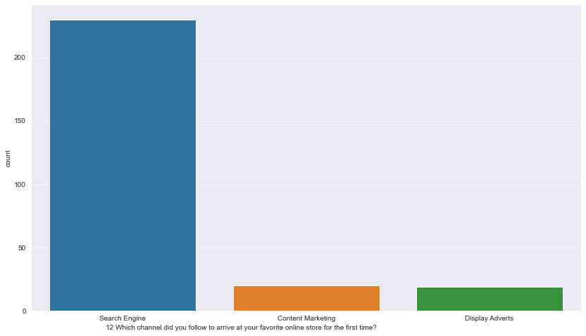
Customer’s Channel for Online Shopping
Search Engine 230
Content Marketing 20
Display Adverts 19

Slide 20
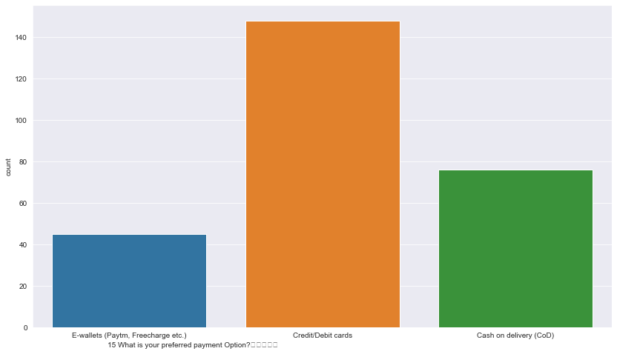
Customer’s Preferred Payment Method
>For about 55% of the customers the preferred payment option is Credit/Debit cards.
>E-wallets are still the least preferred option.
Credit/Debit cards 148
Cash on delivery (Cod) 76
E-wallets (Paytm, Free charge etc.) 45

Slide 21
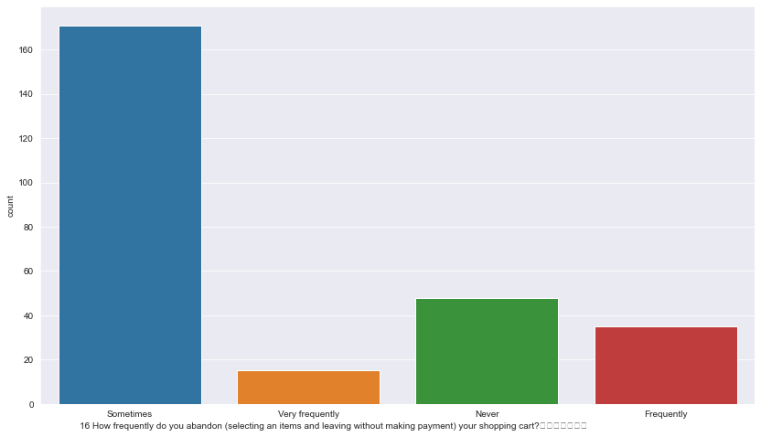
How Frequently Customer’s Abandon their Shopping
A large portion of the population abandon the shopping cart sometimes.
About 17.84% of the population never abandon the cart.
About 17.5% of the customers abandon the cart frequently/very frequently.

Slide 22
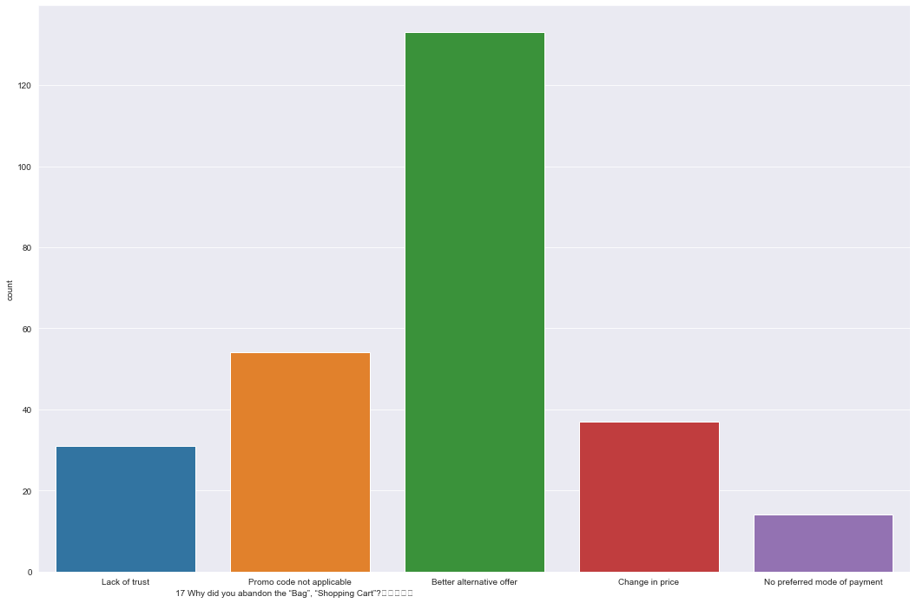
Customer’s Reasons to Abandon their Shopping Bag
The top reason for abandoning the cart is that the customers have found a better alternative offers. This indicates that we need to keep the best offers up to date always.
About 11.52% of the population have a lack of trust in the online stores. This can be fixed by updating the web security and letting the customers know how protected the store is through some policy pages.
At least 5.2% of the customers did not see their preferred mode of payments.

Slide 23
Based on the above graphs it is observed that:
Consumers sometimes abandon items in shopping cart.
Finding a better alternative offer is the most common reason behind why consumers abandon items on a particular e commerce website.

Slide 24
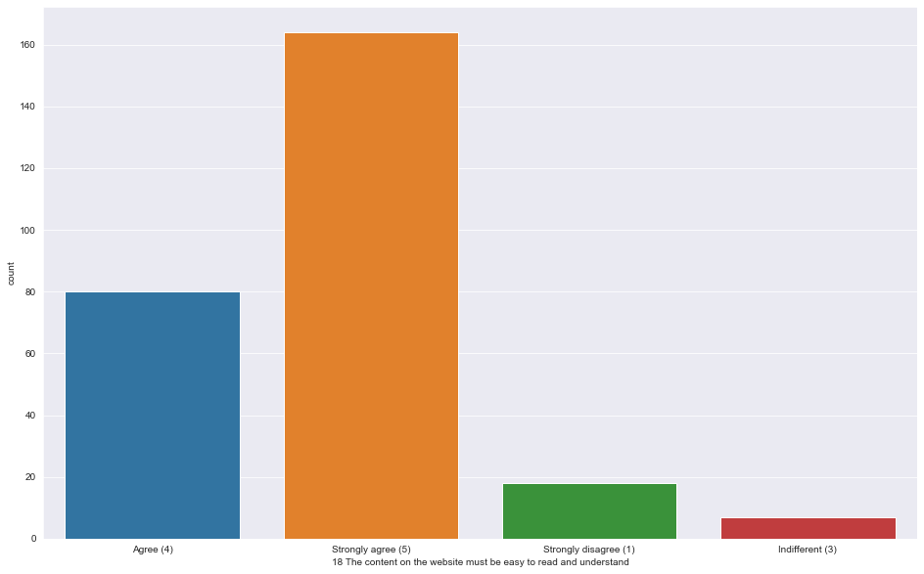
Content on the website must be easy to read and understand
About 90% of the customers Strongly agree that the content on the website must be easy to read and understand.

Slide 25
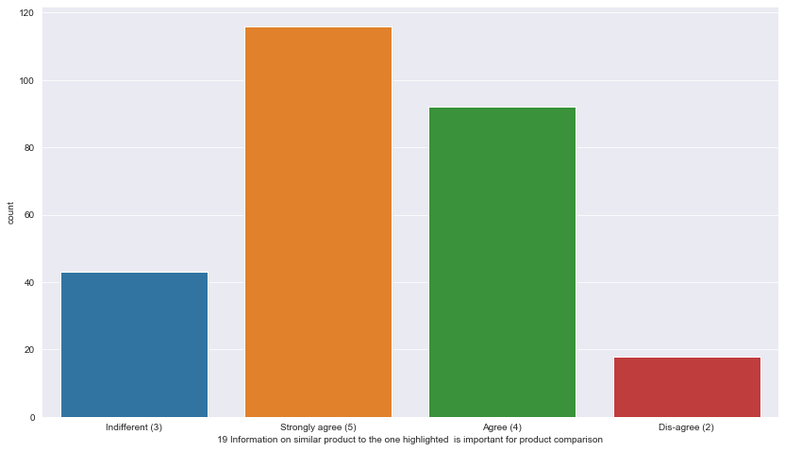
Similar product Information should be Highlighted
About 77% of the population Strongly agree that the information on similar products to the one highlighted is important for product comparison.

Slide 26
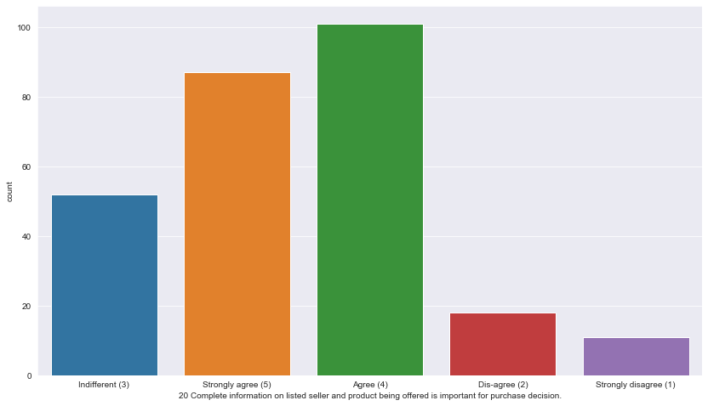
Complete information on listed seller and product being offered
About 69% of the customers strongly agree/agree that the Complete information on listed seller and product being offered is important for purchase decision.

Slide 27
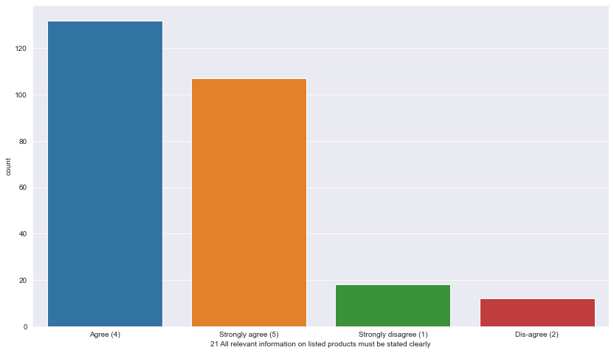
All relevant information on listed products must be stated clearly
About 90% of the customers feel that all relevant information on listed products must be stated clearly

Slide 28
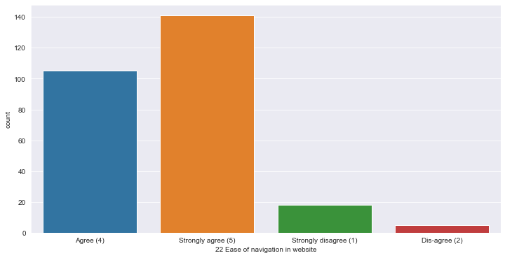
Ease of navigation in website
About 91% of the customers strongly agree that ease of navigation is necessary in a website.

Slide 29
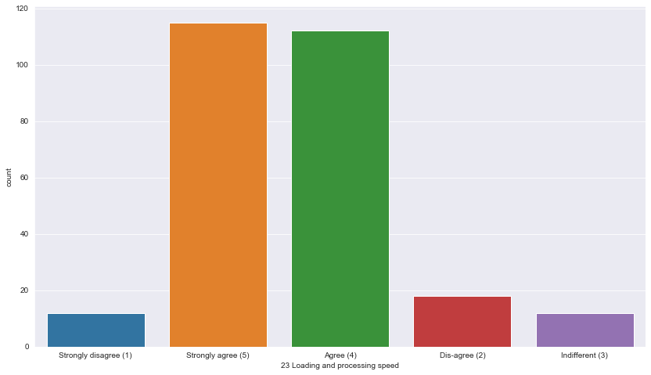
Loading and processing speed
As expected most customers agree/strongly agree that loading and processing speed is important.

Slide 30
User friendly Interface of the website
At least 70% of the customers strongly agree that the interface of the website should be user friendly.

Slide 31
Analyzing the opinions of the participants on the various features of the e-commerce websites reveals that Majority of the consumers strongly agree that:
The content on the website must be easy to read and understand
Information on similar product to the one highlighted is important for product comparison
Complete information on listed seller and product being offered is important for purchase decision
All relevant information on listed products must be stated clearly
Navigation in website should be easy
Loading and processing should be quick
Interface of the website must be user friendly

Slide 32
Website Features must be there according to customer
Convenient Payment methods should be available
There is trust in the online retail store fulfilling its part of the transaction at the stipulated time
There should be Empathy (readiness to assist with queries) towards the customers
Online retail store should be able to guarantee the privacy of the customer
There should be Responsiveness, availability of several communication channels (email, online rep, twitter, phone etc.)
Online shopping gives monetary benefit and discounts
Enjoyment is derived from shopping online
Shopping online is convenient and flexible
Return and replacement policy of the e-tailer is important for purchase decision

Slide 33
Website Features must be there according to customer
Gaining access to loyalty programs is a benefit of shopping online
Displaying quality Information on the website improves satisfaction of customers
User derive satisfaction while shopping on a good quality website or application
Net Benefit is derived from shopping online can lead to users satisfaction
User satisfaction cannot exist without trust
E commerce websites must Offer a wide variety of listed product in several category
There should be Provision of complete and relevant product information
Monetary savings must be considerable

Slide 34
Website Features must be there according to customer
The Convenience of patronizing the online retailer
Shopping on the website gives you the sense of adventure
Shopping on your preferred e-tailer enhances your social status
You feel gratification shopping on your favorite e-tailer
Shopping on the website helps you fulfill certain roles
Getting value for money spent is important

Slide 35
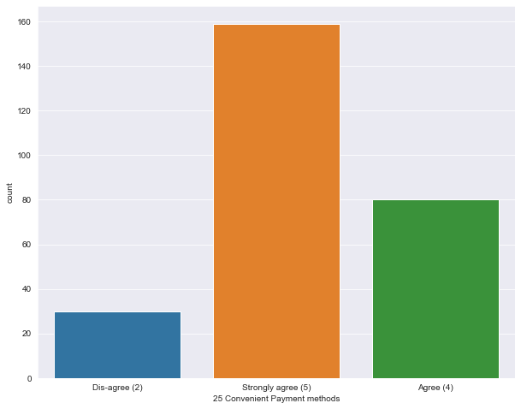
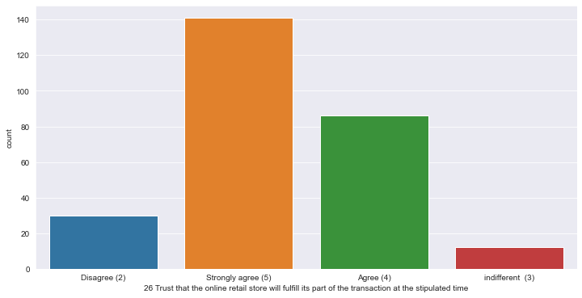
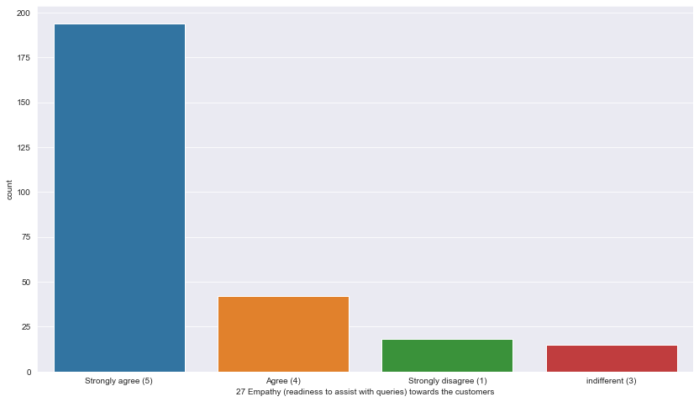
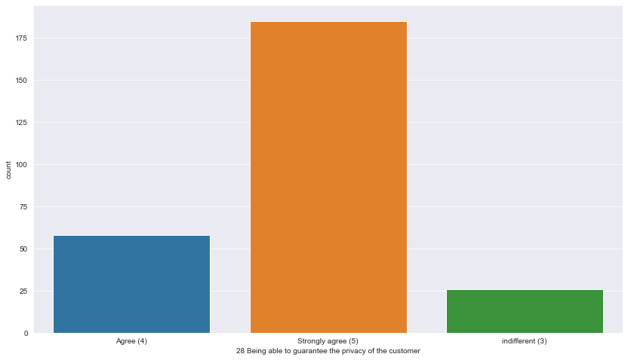
Convenient Payment Method Trust Online Seller
Empathy Towards Customer Privacy of Customer

Slide 36
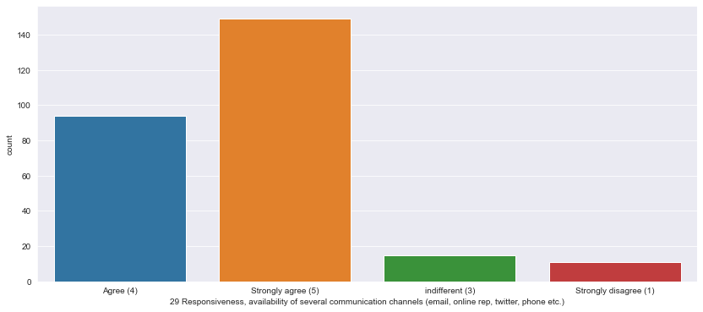
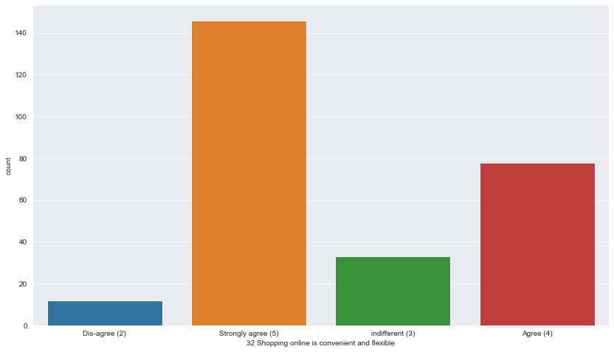
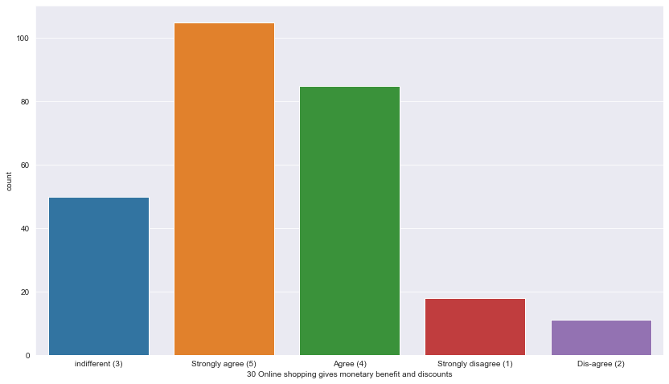
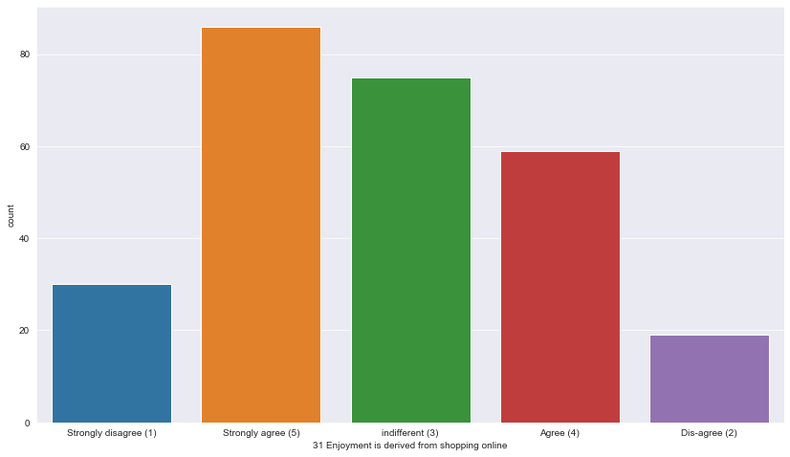

Slide 37
Preferences and Opinions
Analyzing the Preferences and opinions of the participants regarding the e-commerce websites reveals that:
Amazon.in, Flipkart.com, Paytm.com, Myntra.com, Snapdeal.com are the most popular e-commerce websites.
Amazon.in, Flipkart.com, Paytm.com, Myntra.com, Snapdeal.com are the easiest to use websites and applications
Amazon.in and Flipkart.com have the most visually appealing web-page layout.
Amazon.in and Flipkart.com have the widest variety of products on offer
Amazon.in and Flipkart.com have the most complete, relevant description information of products.
Amazon.in, and Paytm.com have the fastest loading speed while Flipkart is regarded by very few as being quick to load

Slide 38
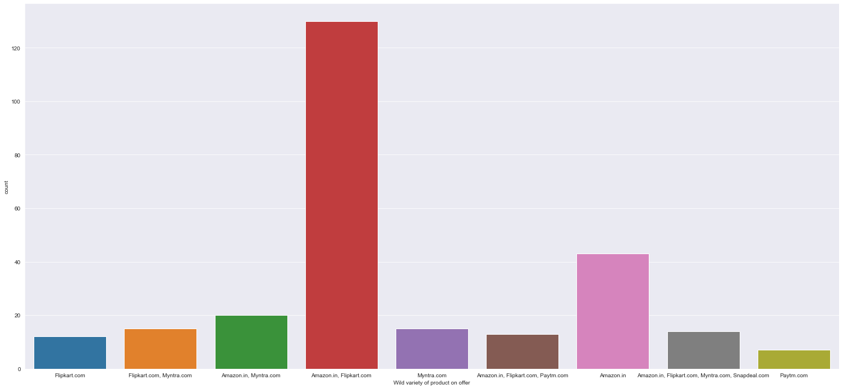
Wide Variety Products Offered
Amazon offers Wide variety products followed by Flipkart

Slide 39
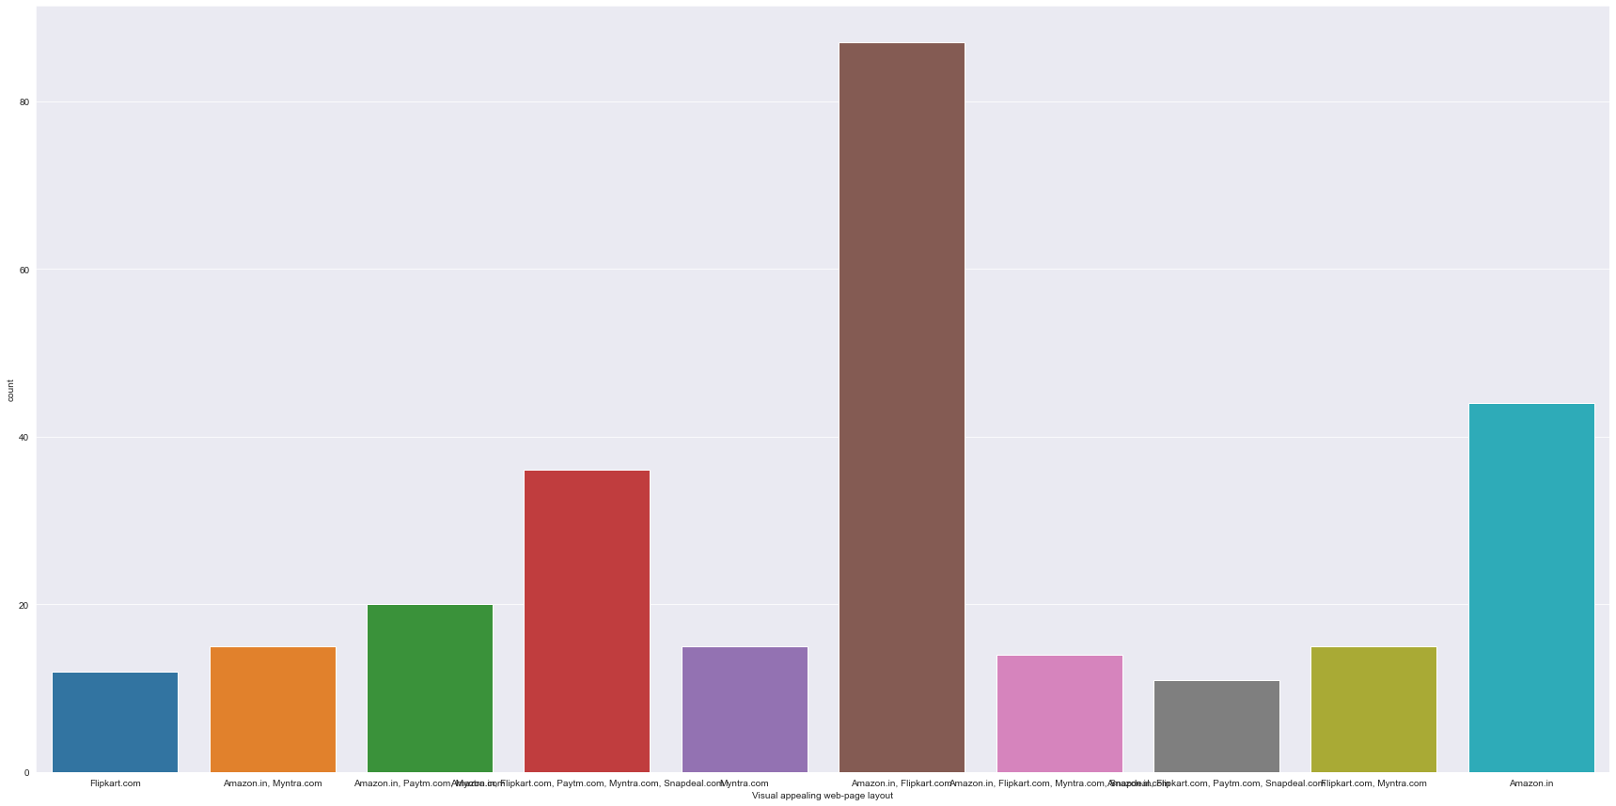
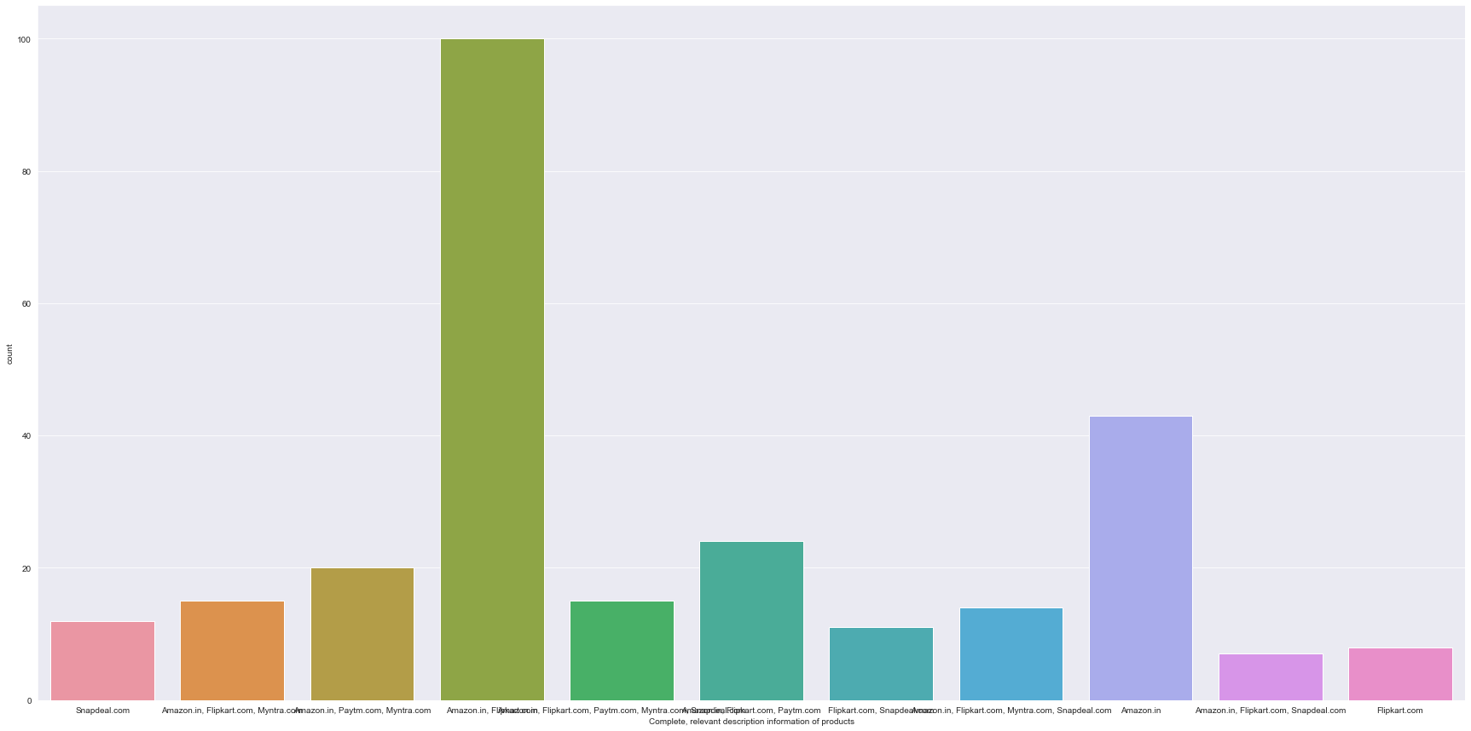
Visualing Appealing Website
Complete Information of products

Slide 40
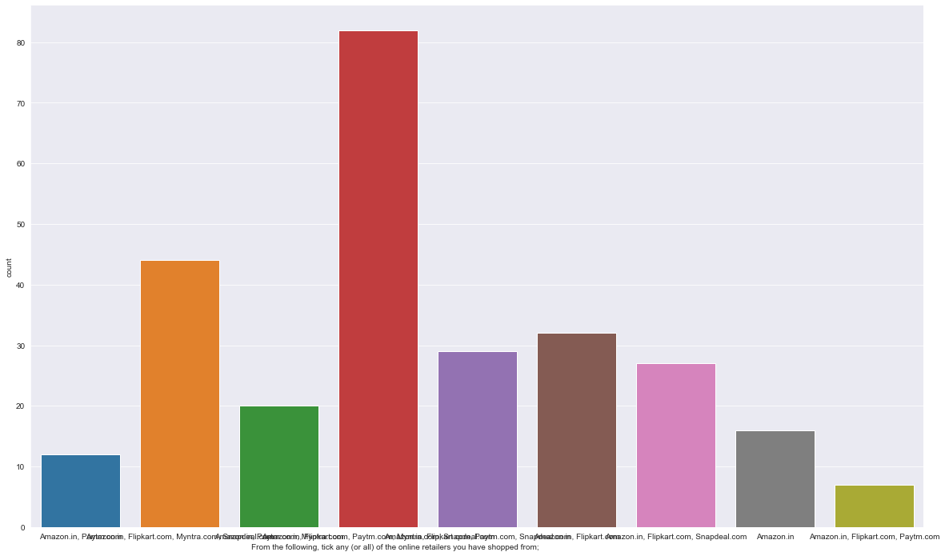
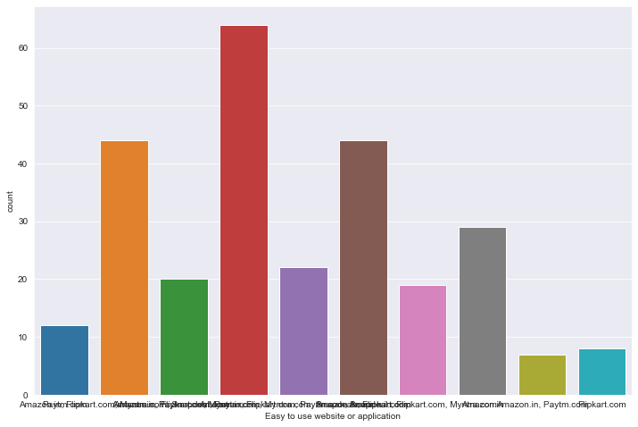
Most Shopped
Easy to Use Website and application

Slide 41
Preferences and Opinions
Amazon.in, Flipkart.com take the longest time displaying graphics and photos during promotion, sales period.
Most people face Late declaration of price on Myntra and Paytm during promotion, sales period.
Myntra and Paytm take the longest page loading time during promotion, sales period.
Snapdeal.com and Amazon.in have the most limited modes of payment on most products during promotion, sales period.
Paytm.com and Snapdeal.com have Longer delivery periods compared to others.
Amazon.in and Paytm.com have had recent changes in website/Application design, as observed by the consumers.

Slide 42
Preferences and Opinions
Amazon.com, Flipkart.com, Paytm.com are considered quick to complete purchases.
Amazon.in, Flipkart.com are regarded by most to have several payment options available
Amazon.in is regarded to offer speedy order delivery by most.
Amazon.in offers the most Privacy for customers’ information.
Amazon.in , followed by Flipkart.com, Paytm.com, Myntra.com, Snapdeal.com provide the best security for customer financial information.
Amazon.in is perceived to be the most trustworthy website by the majority of participants.
Amazon.in, Flipkart.com, Myntra.com, Snapdeal have the highest presence of online assistance through multi-channel.
Most people face longer time to get logged in during promotion, sales period on Amazon.in and Flipkart followed by Paytm and Myntra.

Slide 43
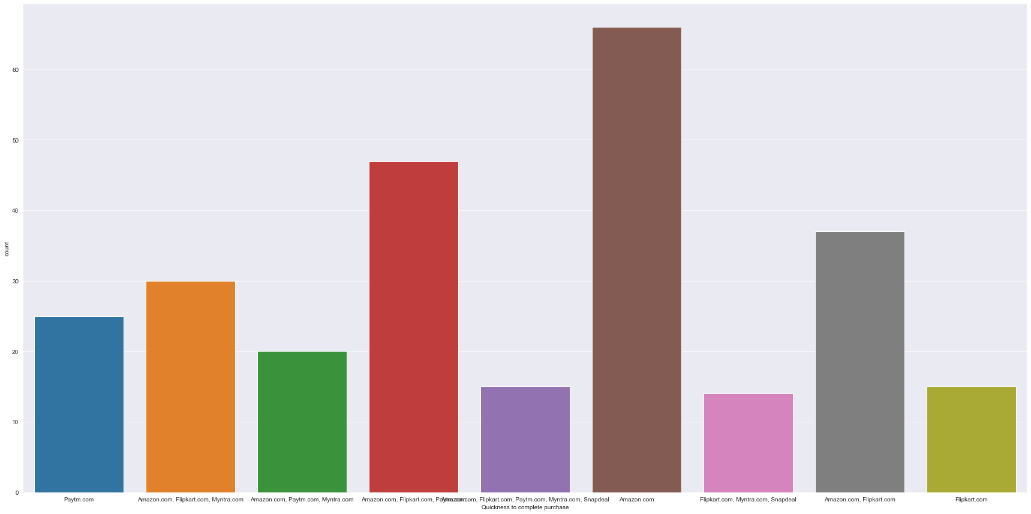
Quickness to complete purchase

Slide 44
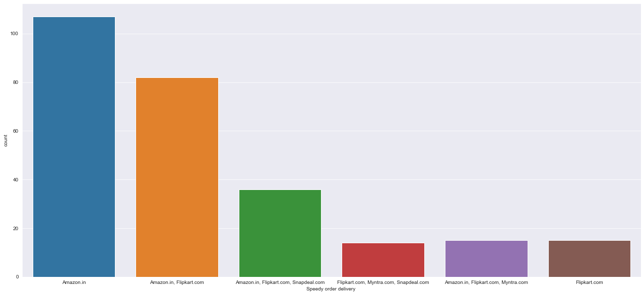
Speedy Order Delivery

Slide 45
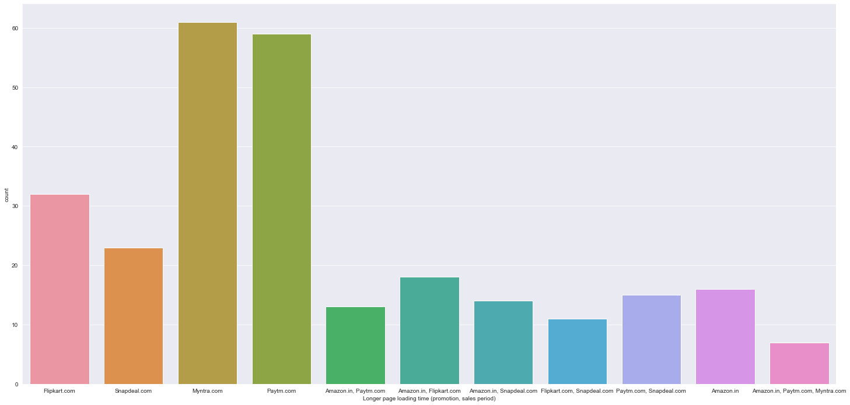
Longer page loading time

Slide 46
Customer Retention and Risks for customer retention
Columns that represent abandoning shopping carts on e commerce websites, reasons behind abandoning shopping carts, Longer delivery period, Website disruption, Customer Data security, Trustworthiness etc. represent perceived risks
While the Column representing the recommended e commerce brands represents customer retention.
The relationships between the columns representing the perceived risks and the column representing Customer retention were visualized and observations were made.

Slide 47
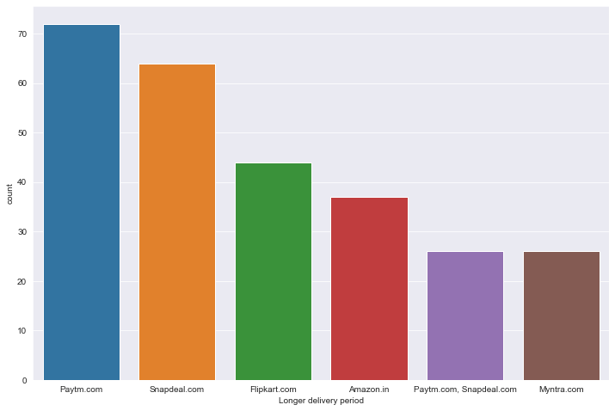
Longer delivery period

Slide 48
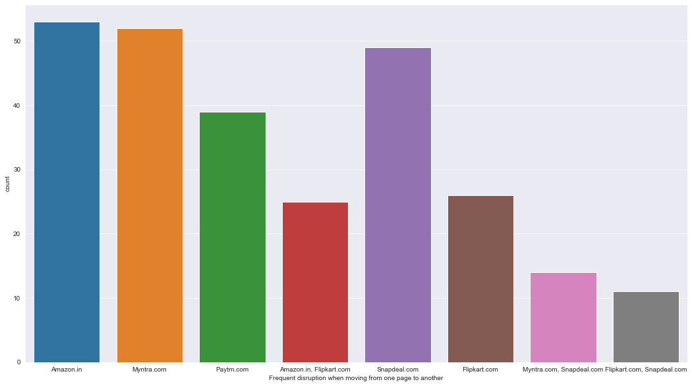
Frequent disruption when moving from one page to another

Slide 49
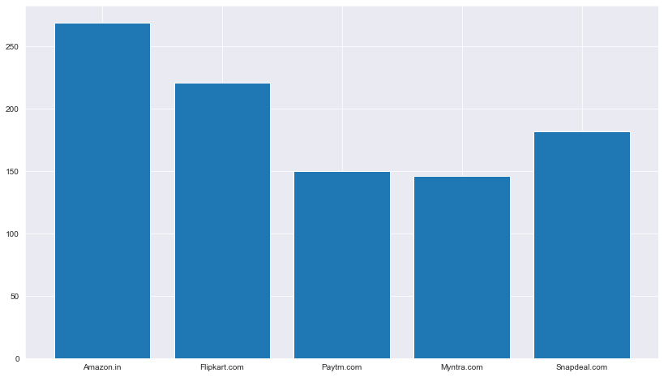
Customer Shopped from
269 customers have used the Amazon.in site.
221 customers have used the Flipkart.com site.
150 customers have used the Paytm.com site.
146 customers have used the Myntra.com site.
182 customers have used the Snapdeal.com site.
Most of the customers are using Amazon websites.
Flipkart and Snapdeal are 2 and 3 position resp.
Paytm and Myntra are at bottom.

Slide 50
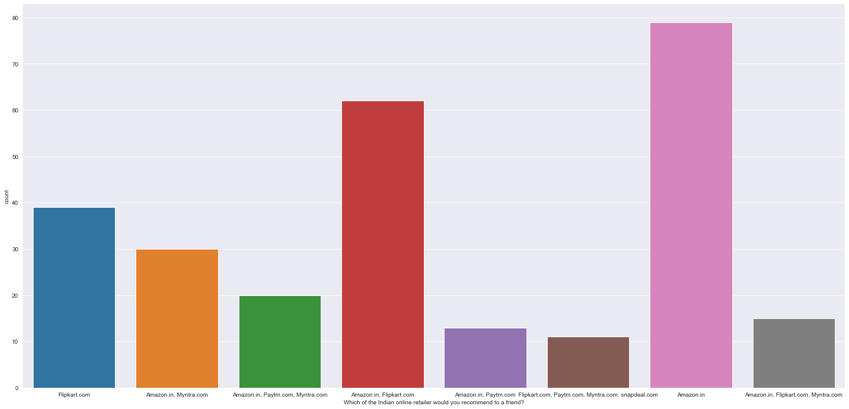
Which of the Indian online retailer would you recommend to a friend

Slide 51
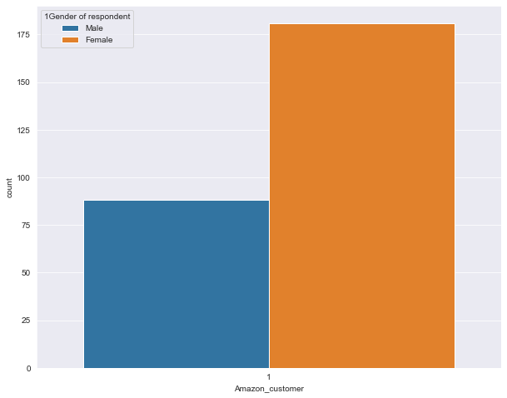

Analyzing Dataset on Gender basis

Slide 52




Slide 53
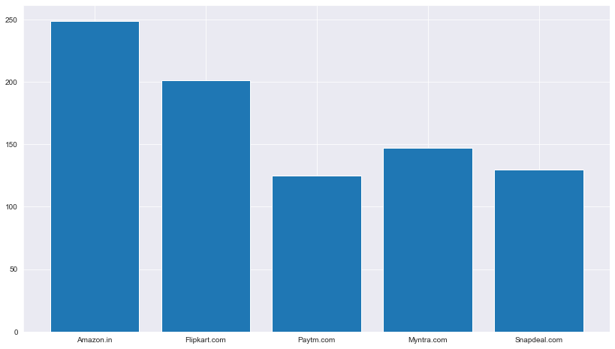
Analyzing Dataset on easy to use website or application
249 customers feels that Amazon.in site is easy to use .
201 customers feels that Flipkart.com site is easy to use .
125 customers feels that Paytm.com site is easy to use .
147 customers feels that Myntra.com site is easy to use .
130 customers feels that Snapdeal.com site is easy to use .
from the above graph ,we can see that Most of the customers feel that Amazon is the most easy to use web store followed by Flipkart.

Slide 54
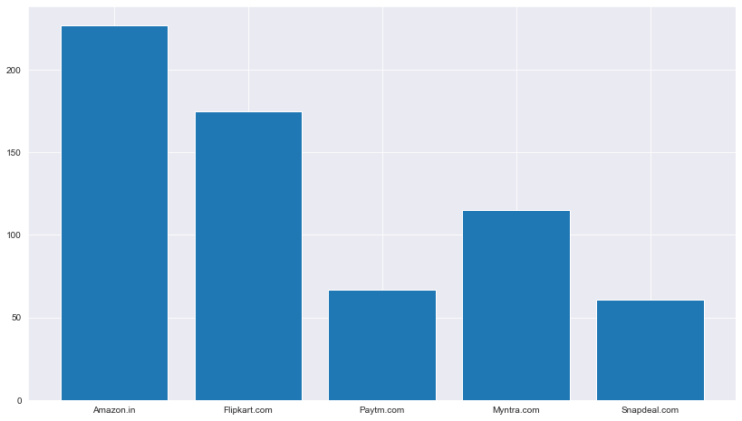
Analyzing Data set on Visual appealing web-page layout:
227 customers feel that the Amazon.in site is visually good.
175 customers feel that the Flipkart.com site is visually good.
67 customers feel that the Paytm.com site is visually good.
115 customers feel that the Myntra.com site is visually good.
61 customers feel that the Snapdeal.com site is visually good.

Slide 55
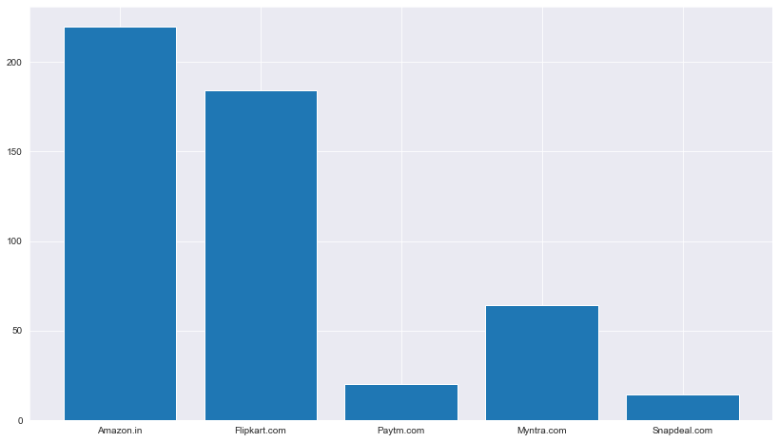
Wild variety of product on offer
220 customers feel that the Amazon.in site has wide variety of products on offer.
184 customers feel that the Flipkart.com site has wide variety of products on offer.
20 customers feel that the Paytm.com site has wide variety of products on offer.
64 customers feel that the Myntra.com site has wide variety of products on offer.
14 customers feel that the Snapdeal.com site has wide variety of products on offer.

Slide 56
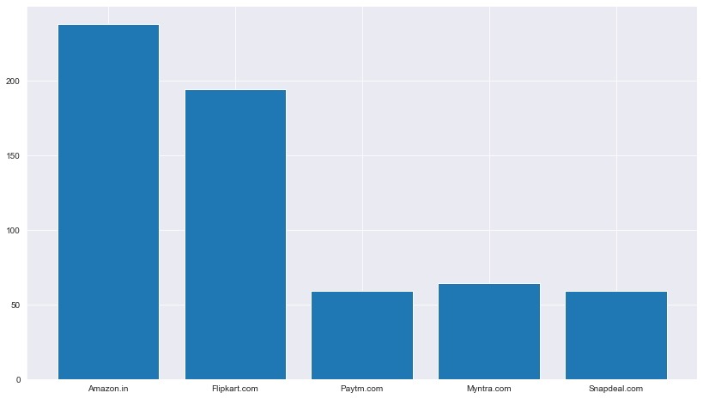
Complete, relevant description information of products
238 customers feel that the Amazon.in site has complete and relevant description information of Products.
194 customers feel that the Flipkart.com site has complete and relevant description information of Products.
59 customers feel that the Paytm.com site has complete and relevant description information of Products.
64 customers feel that the Myntra.com site has complete and relevant description information of Products.
59 customers feel that the Snapdeal.com site has complete and relevant description information of Products.

Slide 57
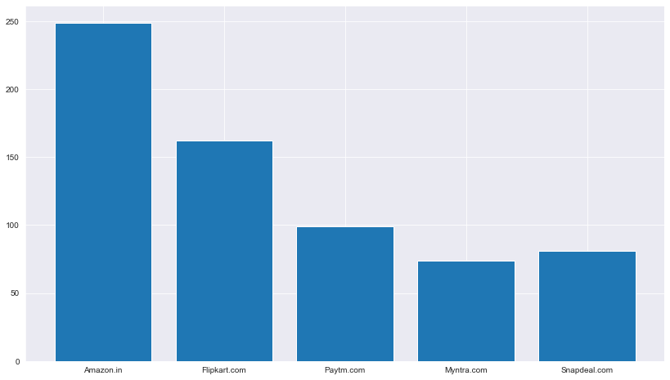
Fast loading website speed of website and application
249 customers feel that the Amazon.in site has Fast loading website speed of website and application.
162 customers feel that the Flipkart.com site has Fast loading website speed of website and application.
99 customers feel that the Paytm.com site has Fast loading website speed of website and application.
74 customers feel that the Myntra.com site has Fast loading website speed of website and application.
81 customers feel that the Snapdeal.com site has Fast loading website speed of website and application.

Slide 58
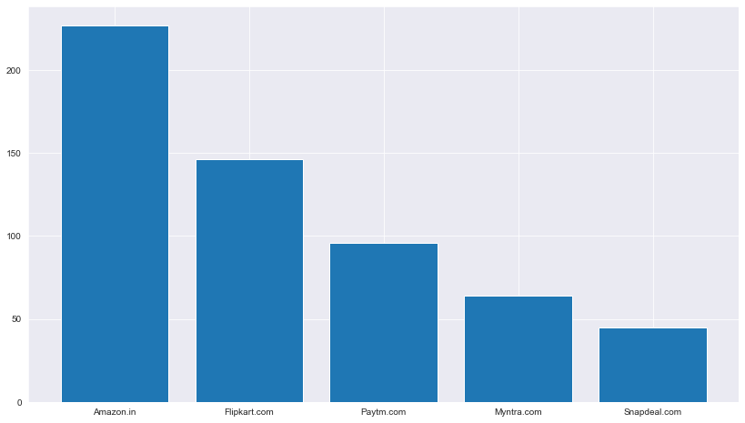
Reliability of the website or application
227 customers feel that the Amazon.in site has Reliability of the website or application.
146 customers feel that the Flipkart.com site has Reliability of the website or application.
96 customers feel that the Paytm.com site has Reliability of the website or application.
64 customers feel that the Myntra.com site has Reliability of the website or application.
45 customers feel that the Snapdeal.com site has Reliability of the website or application.

Slide 59
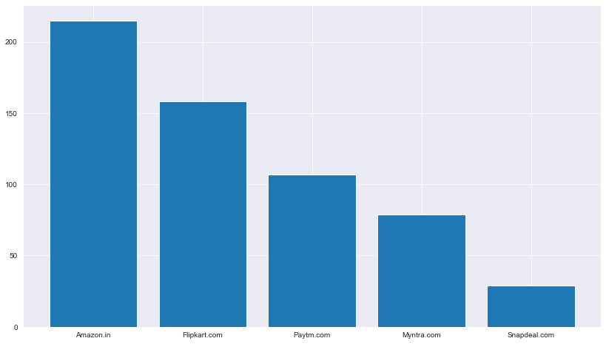
Quickness to complete purchase
215 customers feel that the Amazon.in site is quick to complete purchase.
158 customers feel that the Flipkart.com site is quick to complete purchase.
107 customers feel that the Paytm.com site is quick to complete purchase.
79 customers feel that the Myntra.com site is quick to complete purchase.
29 customers feel that the Snapdeal.com site is quick to complete purchase.
Amazon is the quickest to complete purchases.

Slide 60
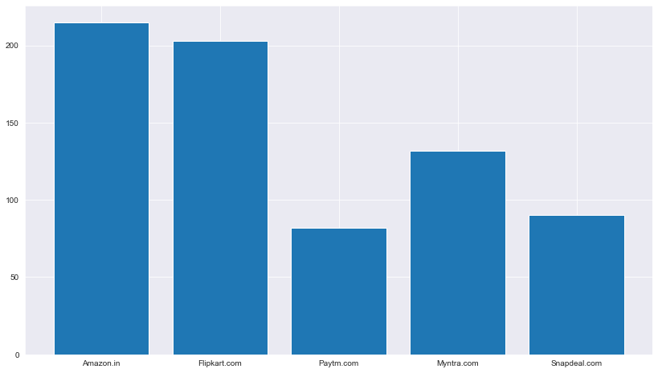
Availability of several payment options
215 customers feel that the Amazon.in site has several payment options.
203 customers feel that the Flipkart.com site has several payment options.
82 customers feel that the Paytm.com site has several payment options.
132 customers feel that the Myntra.com site has several payment options.
90 customers feel that the Snapdeal.com site has several payment options.
Amazon has several payment options.

Slide 61
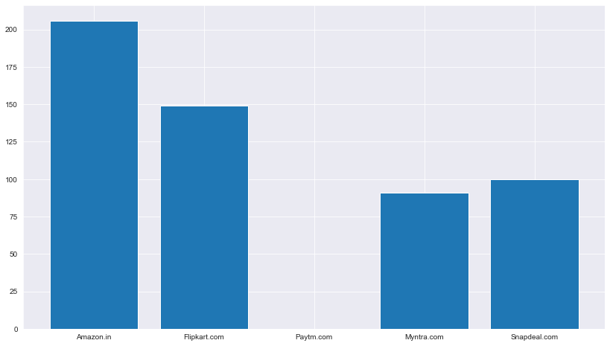
Security of customer financial information
206 customers feel that Security of customer financial information in the Amazon.in site.
149 customers feel that Security of customer financial information in the Flipkart.com site.
0 customers feel that Security of customer financial information in the Paytm.com site.
91 customers feel that Security of customer financial information in the Myntra.com site.
100 customers feel that Security of customer financial information in the Snapdeal.com site.
Customers feel that the Amazon site has the most security for financial information .
Paytm is least secured as per customer

Slide 62
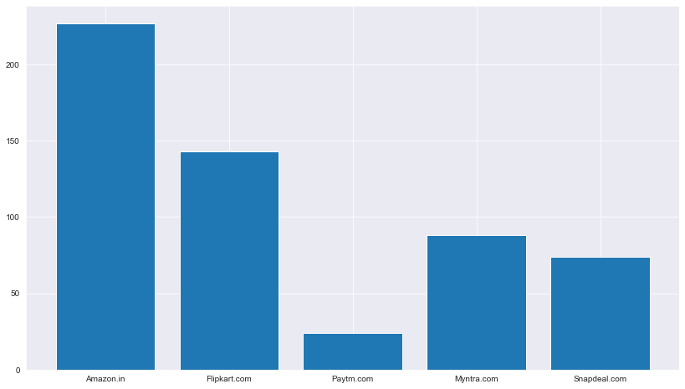
Perceived Trustworthiness
227 customers feel that the Amazon.in site has Perceived Trustworthiness.
143 customers feel that the Flipkart.com site has Perceived Trustworthiness.
24 customers feel that the Paytm.com site has Perceived Trustworthiness.
88 customers feel that the Myntra.com site has Perceived Trustworthiness.
74 customers feel that the Snapdeal.com site has Perceived Trustworthiness.
Most trustworthy site is Amazon.
The least trustworthy site per the survey is Paytm.

Slide 63

Which of the Indian online retailer would you recommend to a friend?
Amazon is the most recommended store followed by Flipkart.
Flipkart is at second place

Slide 64
Customer Retention and Risks for customer retention
It is observed that those who prefer Flipkart.com,Paytm.com,Myntra.com and Snapdeal.com to Amazon.in do so because they face frequent disruption when moving from page to page on Amazon.in
Those who prefer Amazon.in and Flipkart.com face longer page loading time during promotion and sales period on snapdeal.com and myntra.com
Amazon.in has the highest trustworthiness as perceived by most consumers.
Amazon.in,Flipkart.com,Paytm.com have the highest security for customer financial information.
Amazon.in,Flipkart.com,Paytm.com maintain the greatest privacy for customer information.
Customers who believe that user satisfaction can’t exist without trust recommend Amazon.in and Flipkart.com
Those customers who recommend Amazon.in and Flipkart.com the most trust that online retail stores will fulfill their part of the transaction at the stipulated time

Slide 65
Customers face the longest time to get logged in on Amazon.in and Flipkart.com the most and yet, recommend those 2 websites the most.
Customers prefer Amazon.in and Flipkart.com To Myntra.com and Snapdeal.com because Myntra and Snapdeal take longer to display graphics and photos during promotion and sales period.
Customers prefer Amazon.in and Flipkart.com To Myntra.com and Snapdeal.com because Myntra and Snapdeal take too long to declare prices during promotion and sales period

Slide 66
Analyzing Relationship between Customer retention and Hedonic Value
Hedonic Values serve the purpose of giving emotional / multisensory gratification and a sense of fulfillment of a role to Consumers.
Columns that represent Enjoyment derived from shopping online,Satisfaction of shopping on a good quality website,access to loyalty programs,Sense adventure in shopping online,Social status enhancement from shopping online,feeling a sense of gratification from shopping online and fulfillment of roles are hedonic values.
The relationships between the columns representing the Hedonic Values and the column representing Customer retention were visualized using the code below and observations were made.
From the graphs above the following observations are made:
Customers who recommend Myntra.com,paytm.com and Amazon.in Strongly agree that enjoyment is derived from shopping online, while those who recommend Flipkart and Amazon.in are indifferent about it.
Gaining Access to loyalty programs is a benefit of shopping online for those who recommend Amazon.in and Flipkart.com
Those who Recommend Amazon.in,flipkart.com and Myntra.com strongly derive satisfaction while shopping on a good quality website / application.
Those who Recommend Amazon.in,flipkart.com,paytm.com and Myntra.com strongly agree that they get a sense of adventure from shopping online.

Slide 67
Analyzing Relationship between Customer retention and Hedonic Value
From the graphs above the following observations are made:
Customers who recommend Myntra.com,paytm.com and Amazon.in Strongly agree that enjoyment is derived from shopping online, while those who recommend Flipkart and Amazon.in are indifferent about it.
Gaining Access to loyalty programs is a benefit of shopping online for those who recommend Amazon.in and Flipkart.com
Those who Recommend Amazon.in,flipkart.com and Myntra.com strongly derive satisfaction while shopping on a good quality website / application.
Those who Recommend Amazon.in,flipkart.com,paytm.com and Myntra.com strongly agree that they get a sense of adventure from shopping online.
Although most consumers are indifferent to whether or not shopping on e-commerce websites enhances their social status, Those who recommend Amazon.in,Flipkart.com,paytm.com and myntra.com agree that shopping on those websites enhances their social status.
Most consumers agree that shopping on Amazon.in and Flipkart.com get a sense of gratification from shopping on their favorite e-tailer.
Most consumers agree that shopping on Amazon.in, Flipkart.com, Myntra.com, snapdeal.com and Paytm.com agree that shopping on the websites fulfills certain roles.
Most consumers consider Amazon.in and Flipkart.com to have the most visually appealing web-page layout.
Most consumers who recommend Amazon.in appreciate change in website/application design

Slide 68
Analyzing Relationship between Customer retention and Utilitarian Value
Utilitarian values are based on rational decisions, are goal related and give importance to functional values of products / transactions on websites that are aimed at enhancing customer satisfaction through meaningful online transactions.
Columns that represent Product information, Monetary saving and benefits, net benefits, Payment convenience, ease of browsing the website, Wide variety of products in several categories, Return/replacement policies, delivery time etc are Utilitarian values.
The relationships between the columns representing the Utilitarian Values and the column representing Customer retention were visualized using the code below and observations were made.
Most Consumers who recommend amazon and myntra spend more than 15 minutes on Amazon and Myntra.
Amazon and Flipkart offer the widest varieties of products
Most Consumers who recommend amazon and flipkart Prefer payments via Credit/Debit cards and Cash on Delivery
Most Consumers who recommend amazon and flipkart appreciate the ease of understanding and reading content on the respective websites.
Most Consumers who recommend amazon and flipkart find it important for information on similar product to be available for comparison
Most Consumers who recommend amazon and flipkart find complete product information important.

Slide 69
Analyzing Relationship between Customer retention and Utilitarian Value
Most Consumers who prefer Amazon and flipkart find it important for there to exist Responsiveness and availability of many communication channels.
Most Consumers who recommend Amazon and flipkart find that shopping on there gives them monetary benefits and discounts.
Most Consumers who recommend Amazon find shopping on there convenient and flexible.
Most Consumers recommend Amazon because return and replacement policy is important for purchase decisions.
Most Consumers recommend Amazon and flipkart because they display quality information on websites.
Most Consumers recommend Amazon and flipkart because they believe net benefit is derived from shopping online leads to user satisfaction.
Most Consumers recommend Amazon and flipkart because they offer a wide variety of products in several categories.
Most Consumers recommend Amazon and flipkart because they provide complete and relevant product information.
Most Consumers recommend Amazon,myntra,paytm and flipkart because they offer monetary savings
Most Consumers recommend Amazon and flipkart because they consider convenience of patronizing the online retailer important
Most Consumers recommend Amazon and flipkart because they get value for money spent.

Slide 70
From the graphs above it is observed that:
Most customers abandon their shopping carts on Amazon and flipkart because of change in price or when they find a better deal elsewhere, whereas on paytm,myntra snapdeal etc. the reasons are varied but largely are due to lack of trust or absence of preferred mode of payment.

Slide 71
Final Conclusion
• User-friendly: Ninety percent of customers felt that the website should be user-friendly. Any e-commerce website's navigation is critical to its success. It should be neat, straightforward, and simple to use. To ensure that customers do not become confused while surfing the website, online stores should build easy-to-use navigation.
Customer Privacy Policy: Being able to guarantee the customer's privacy: This was approved by 92 percent of customers. Customers are worried about illegal access to their personal information. For every e-commerce website, establishing client trust is critical. An e-commerce privacy policy statement clarifies how your company collects, manages, and uses data from site users.
• Providing high-quality information on the website/application: 90% of customers feel that all necessary information about the products offered on the website should be explained properly. One of the most important issues for every e-commerce website is content. Simply listing a product name and image on a product page and expecting purchases to come in isn't enough. Creating an appealing collection of product data, whether it's dimensions, MPNs, or other information

Slide 72

Thank You

